Slide 1
Module 3
Project Planning and Scheduling

Slide 2
Contents
Work Breakdown structure (WBS) and linear responsibility chart
Project cost estimation and budgeting
Top down and bottoms up budgeting
Networking and Scheduling techniques
PERT, CPM, GANTT chart
Interface Co-ordination and concurrent engineering
Introduction to Project Management Information System (PMIS)

Slide 3
Project Planning
There are several reasons to use considerable care when planning projects.
The primary purpose of planning, is to establish a set of directions in sufﬁcient detail to tell the project team exactly what must be done, when it must be done, what resources will be required to produce the deliverables of the project successfully, and when each resource will be needed.
The plan must be designed in such a way that the project outcome also meets the objectives of the parent organization, as reﬂected by the project portfolio.

Slide 4
The plan is only an estimate of what and when things must be done to achieve the scope or objectives of the project, it is always carried out in an environment of uncertainty. Therefore, the plan must include allowances for risk and features that allow it to be adaptive, i.e., to be responsive to things that might disrupt it while it is being carried out.
Eg: Scope creep i.e. the tendency of project objectives to be changed by the client, senior management, or individual project workers with little or no discussion with the other parties actively engaged in the work of the project
The plan must include any constraints on activities and input materials prescribed by law and society. Among the many sources of outside constraints are the Food and Drug Administration, the Occupational Health and Safety Administration, various engineering societies, the PMI, Labor Unions, and the “Standards Practices” of many different industries.

Slide 5
The purpose of planning is to facilitate later accomplishment.
The world is full of plans that never become deeds. The planning techniques are intended to smooth the path from idea to accomplishment. It is a complicated process to manage a project, and plans act as a map of this process. The map must have sufﬁcient detail to determine what must be done next but be simple enough.

Slide 6
Project Plan Elements:
Overview
Objectives or Scope
General Approach
Contractual Aspects
Schedules
Resources
Personnel
Risk Management Plans
Evaluation Methods

Slide 7
1. WORK BREAKDOWN STRUCTURE

Slide 9
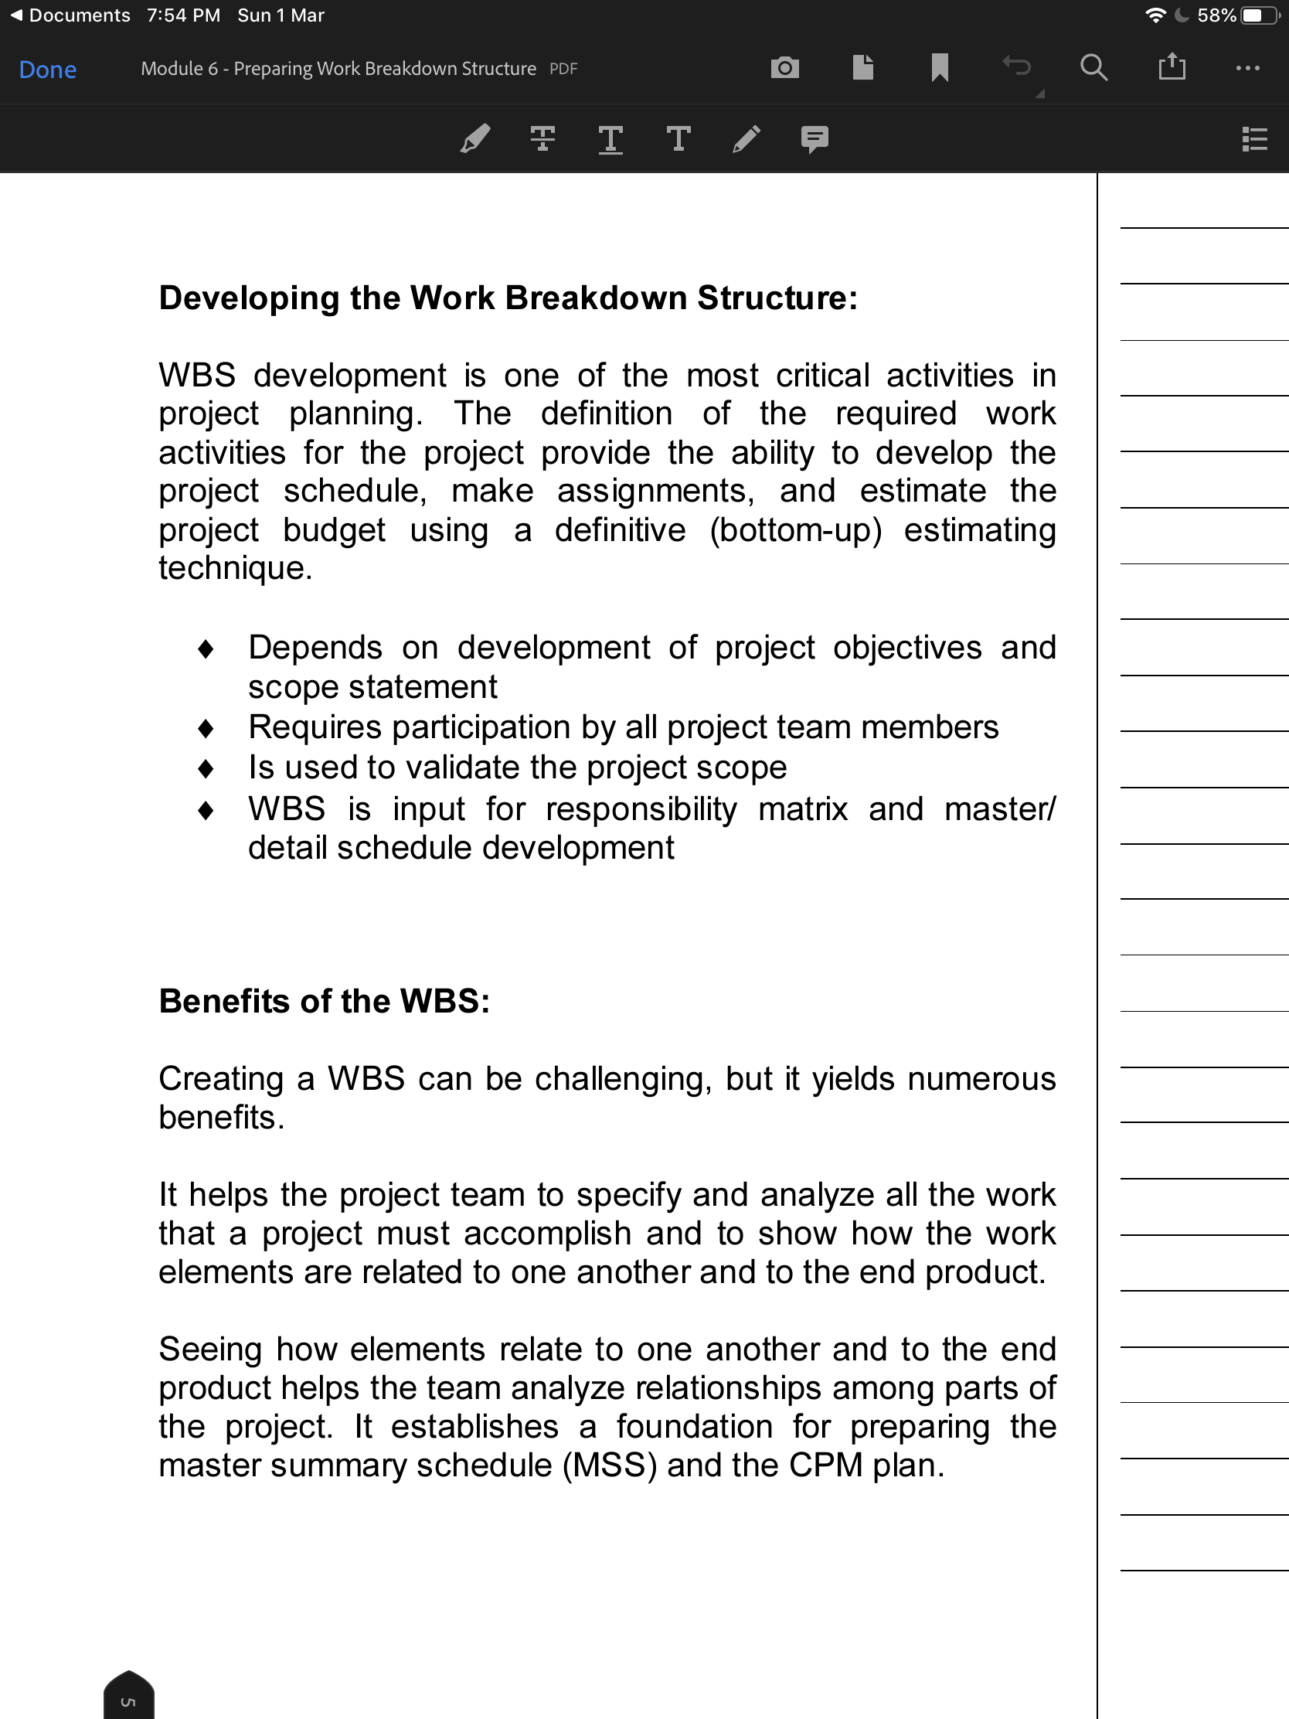

Slide 10
Notes:
This is imp

Slide 11
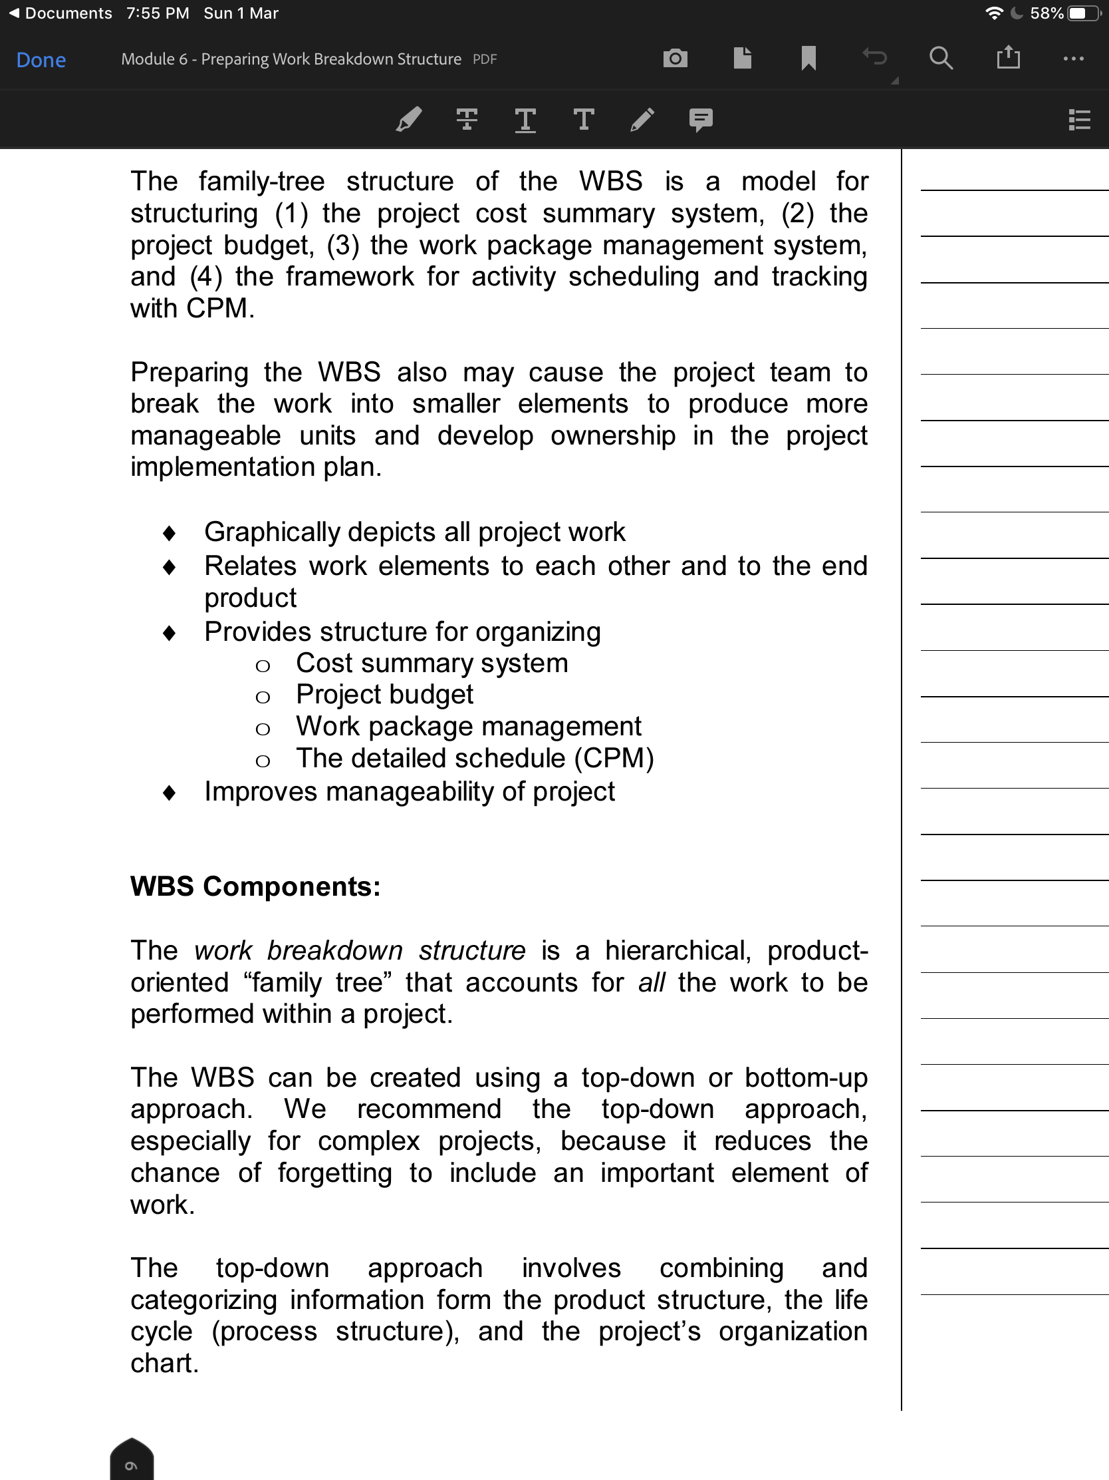

Slide 14
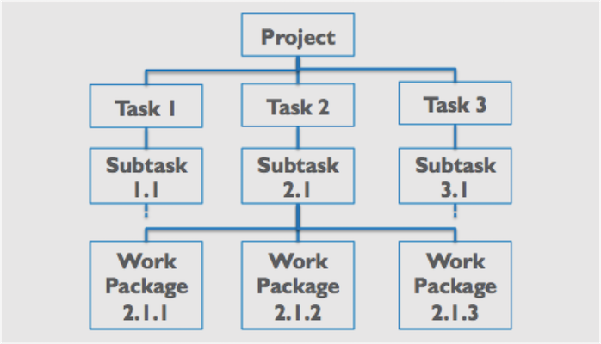

Slide 15
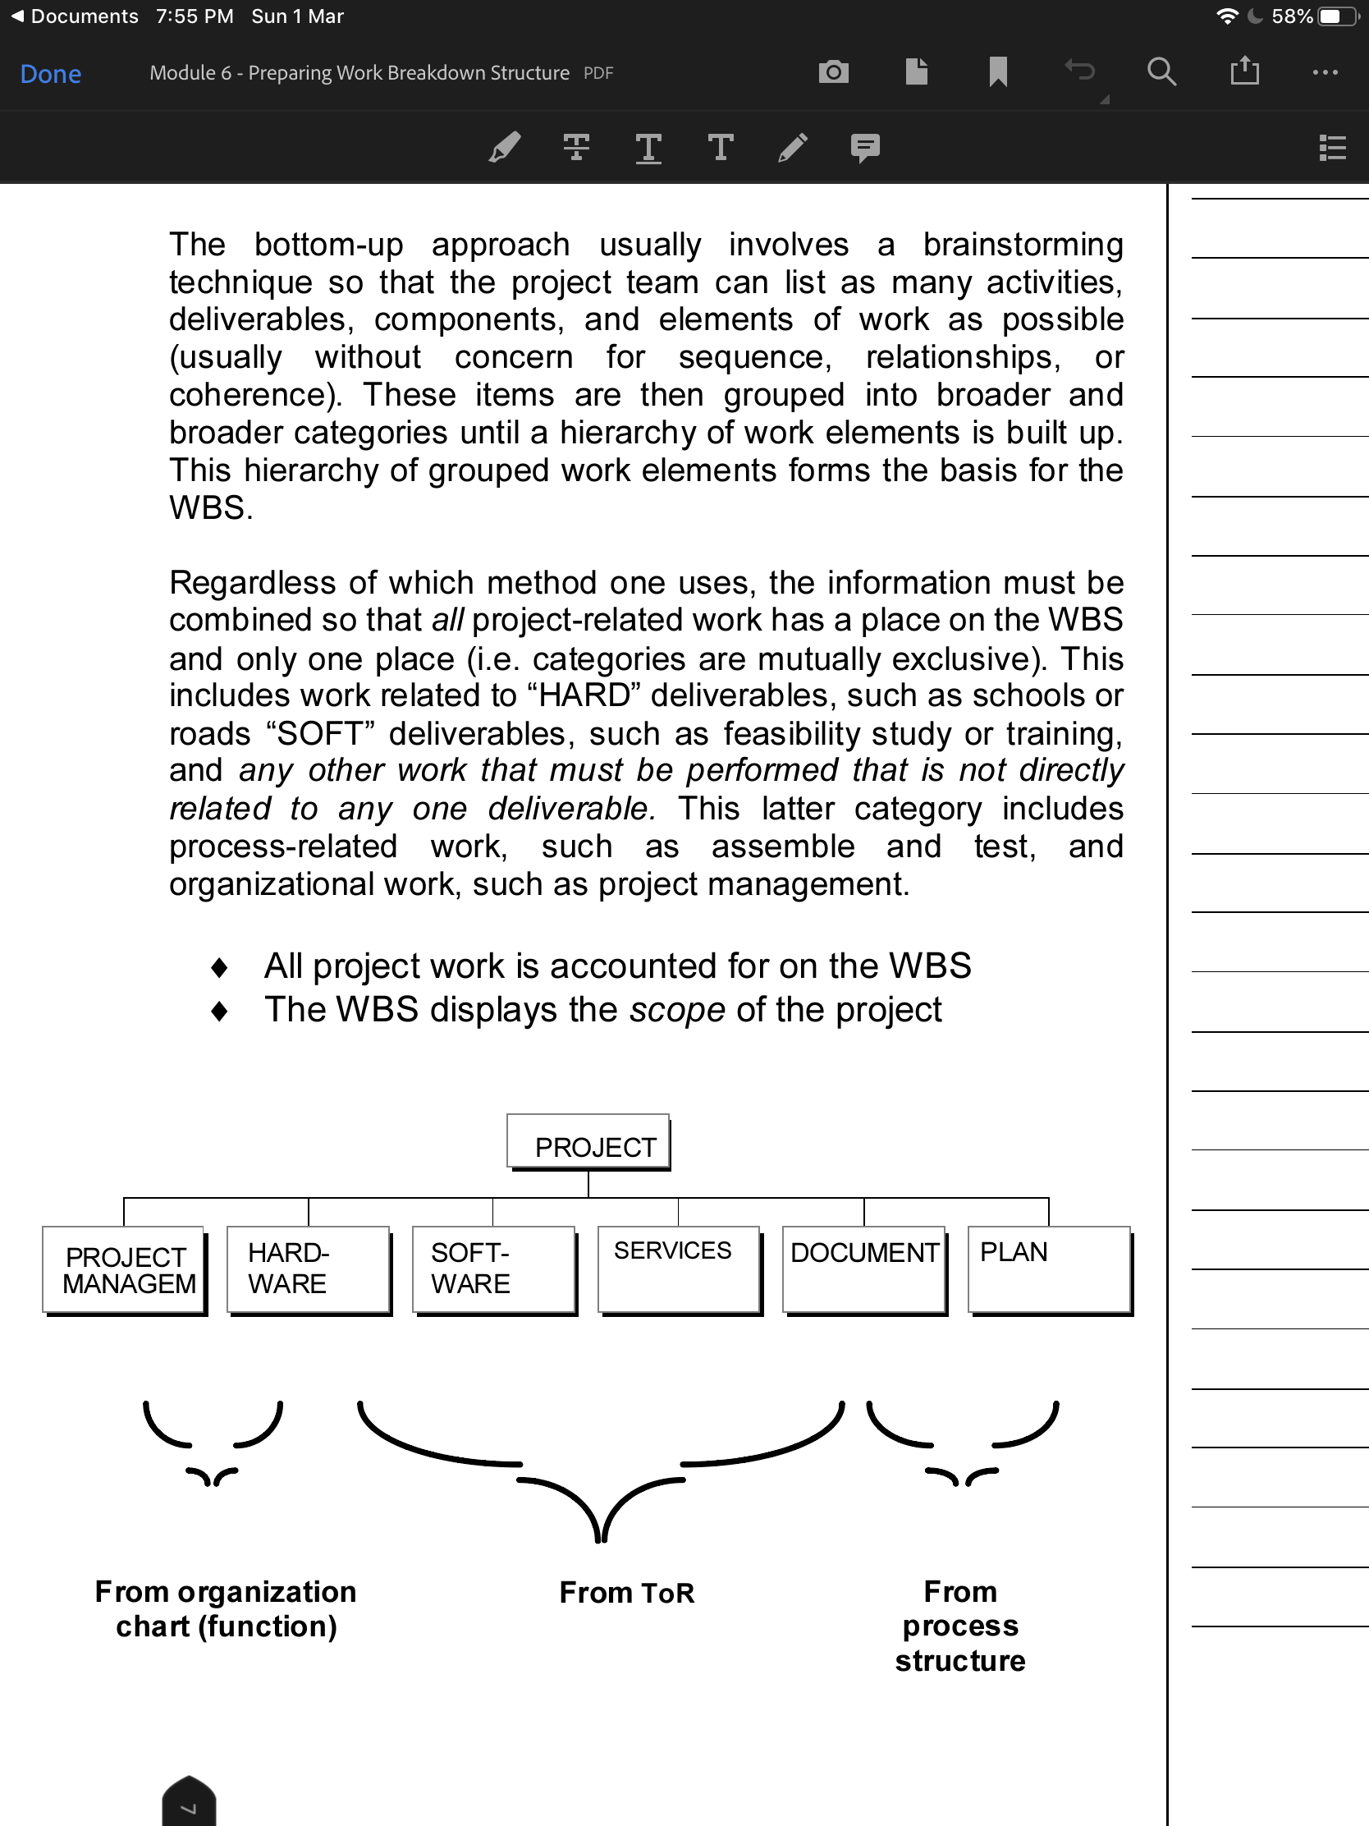

Slide 17
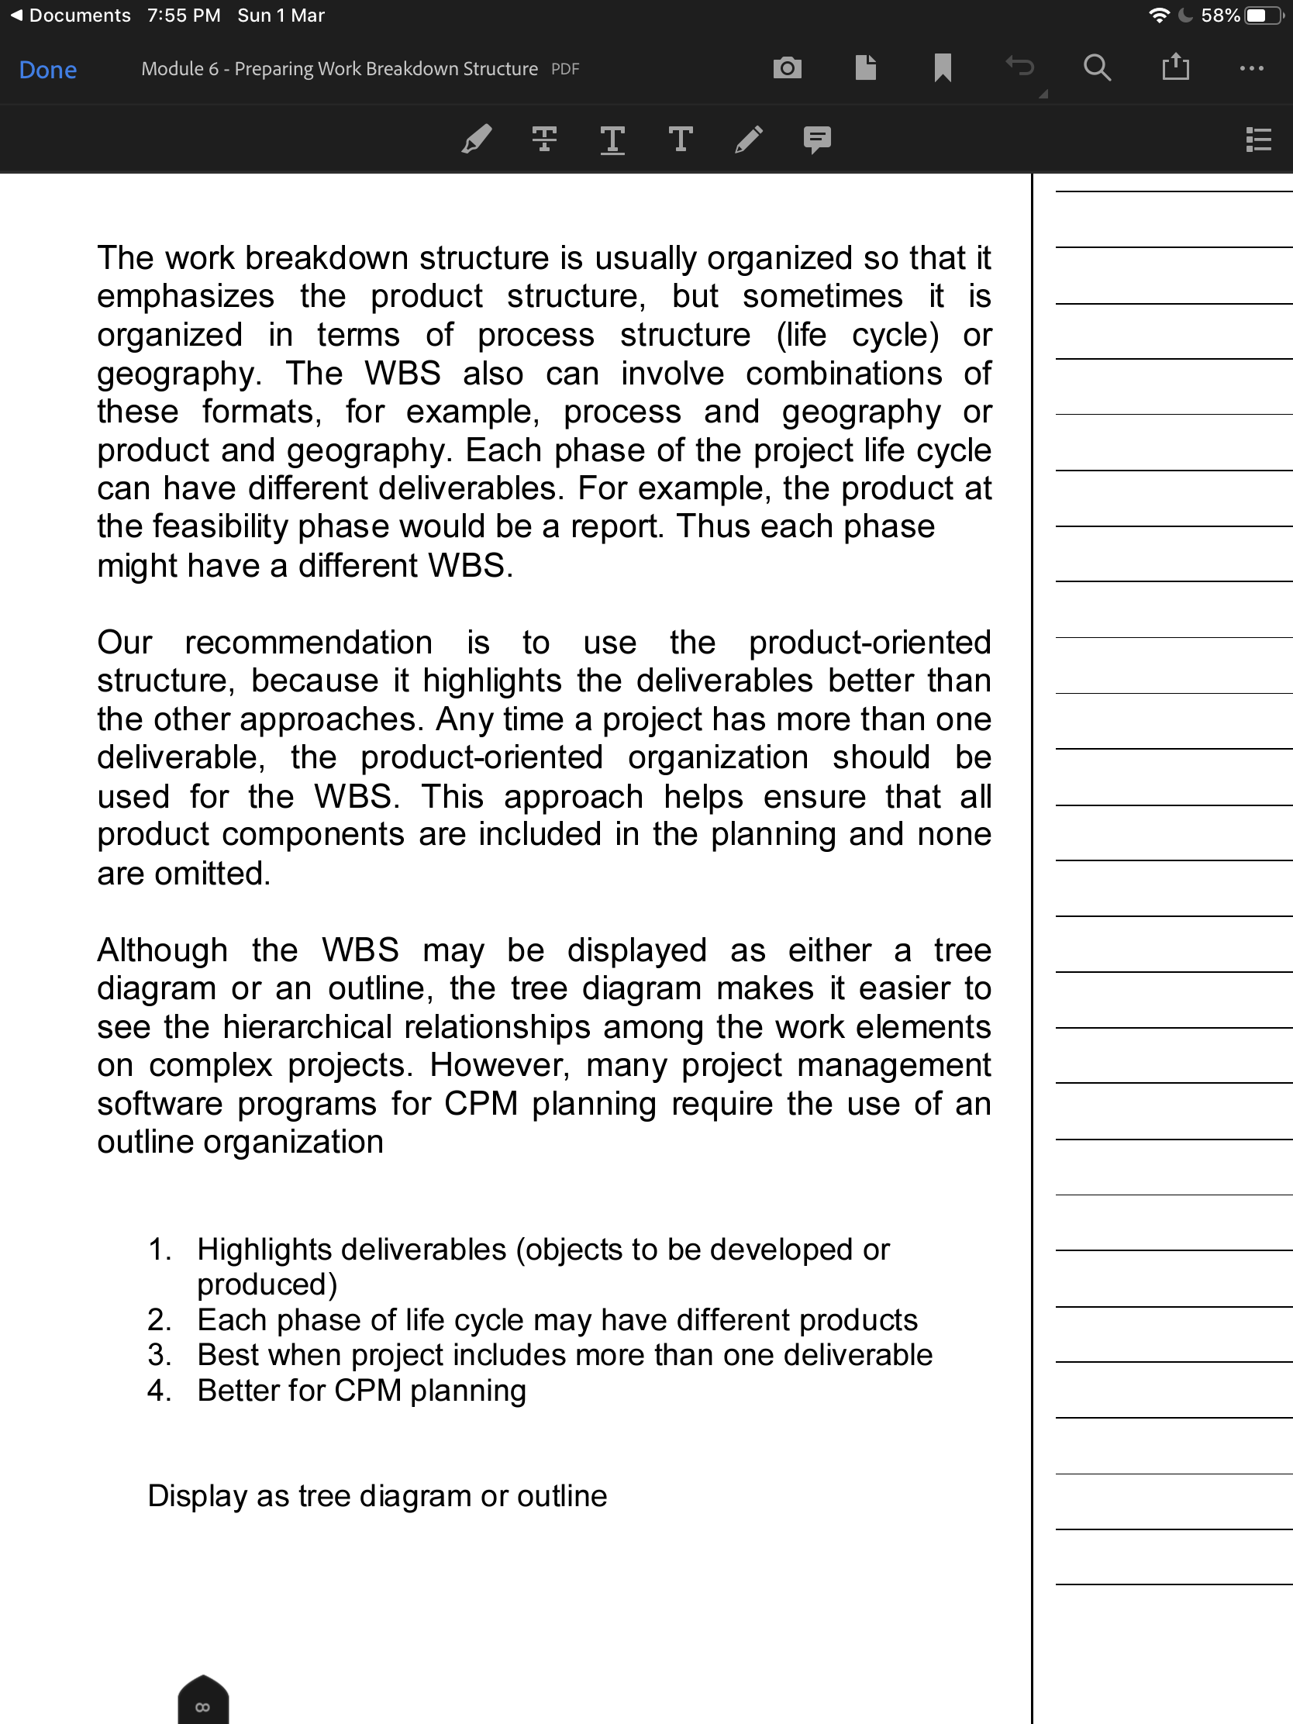

Slide 20
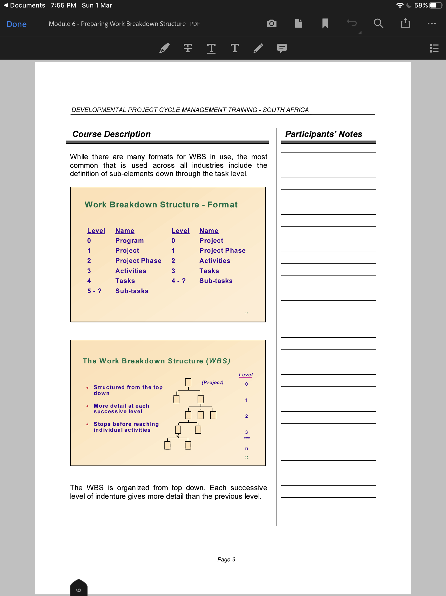

Slide 22
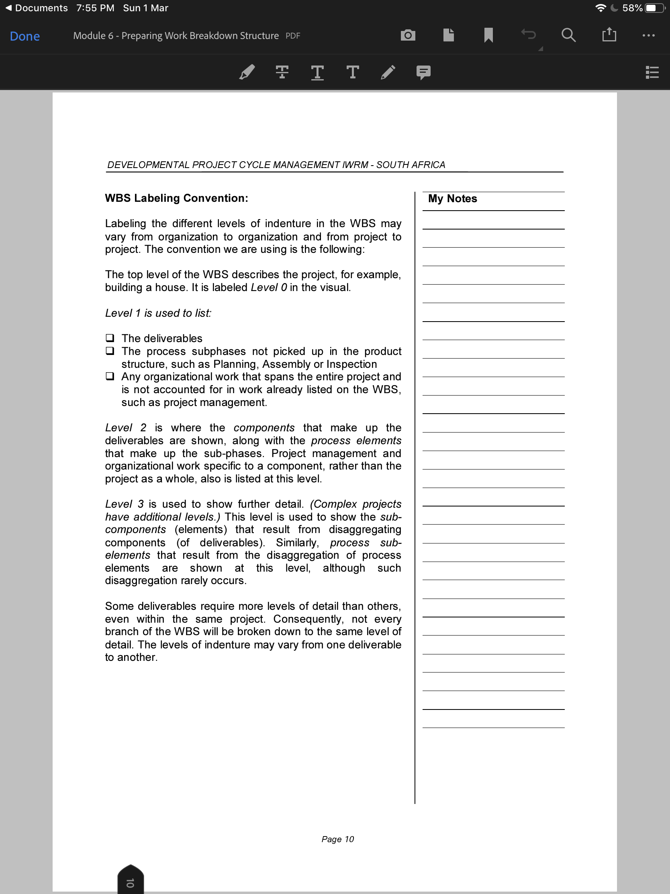

Slide 24
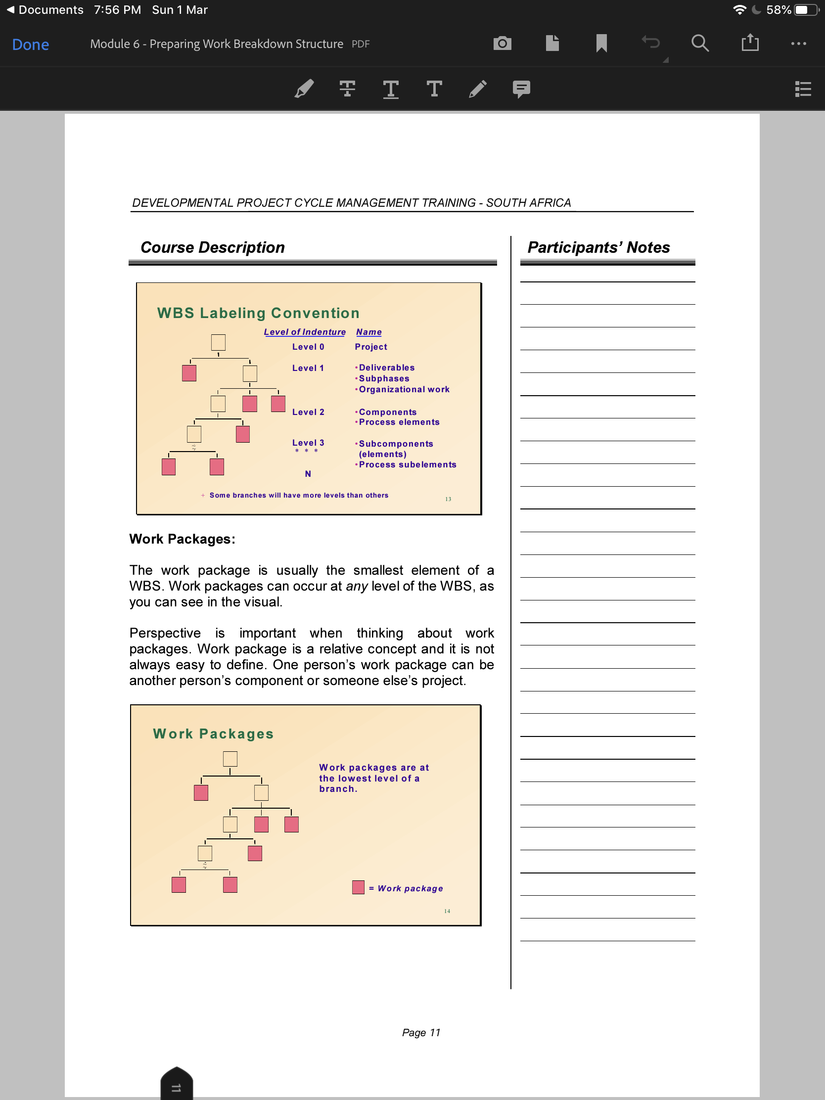

Slide 26
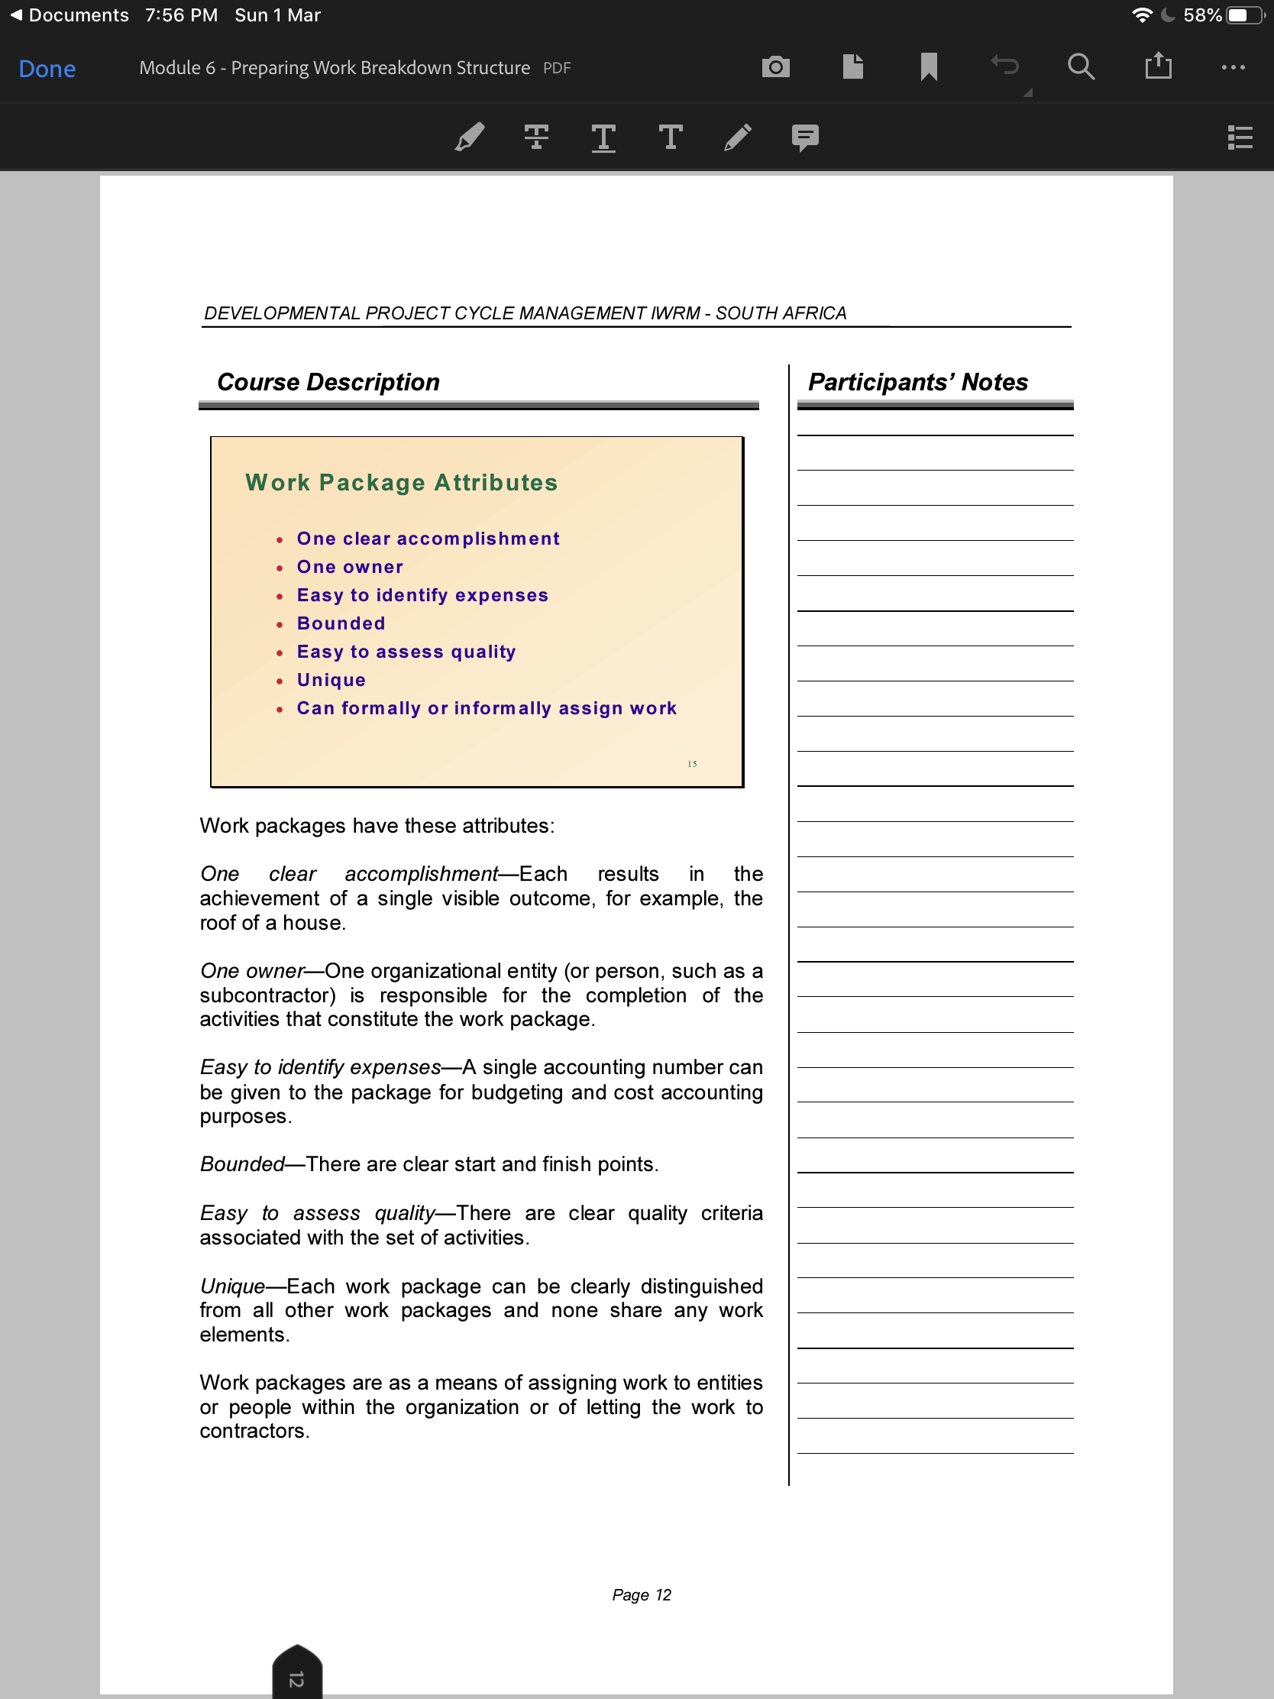

Slide 27
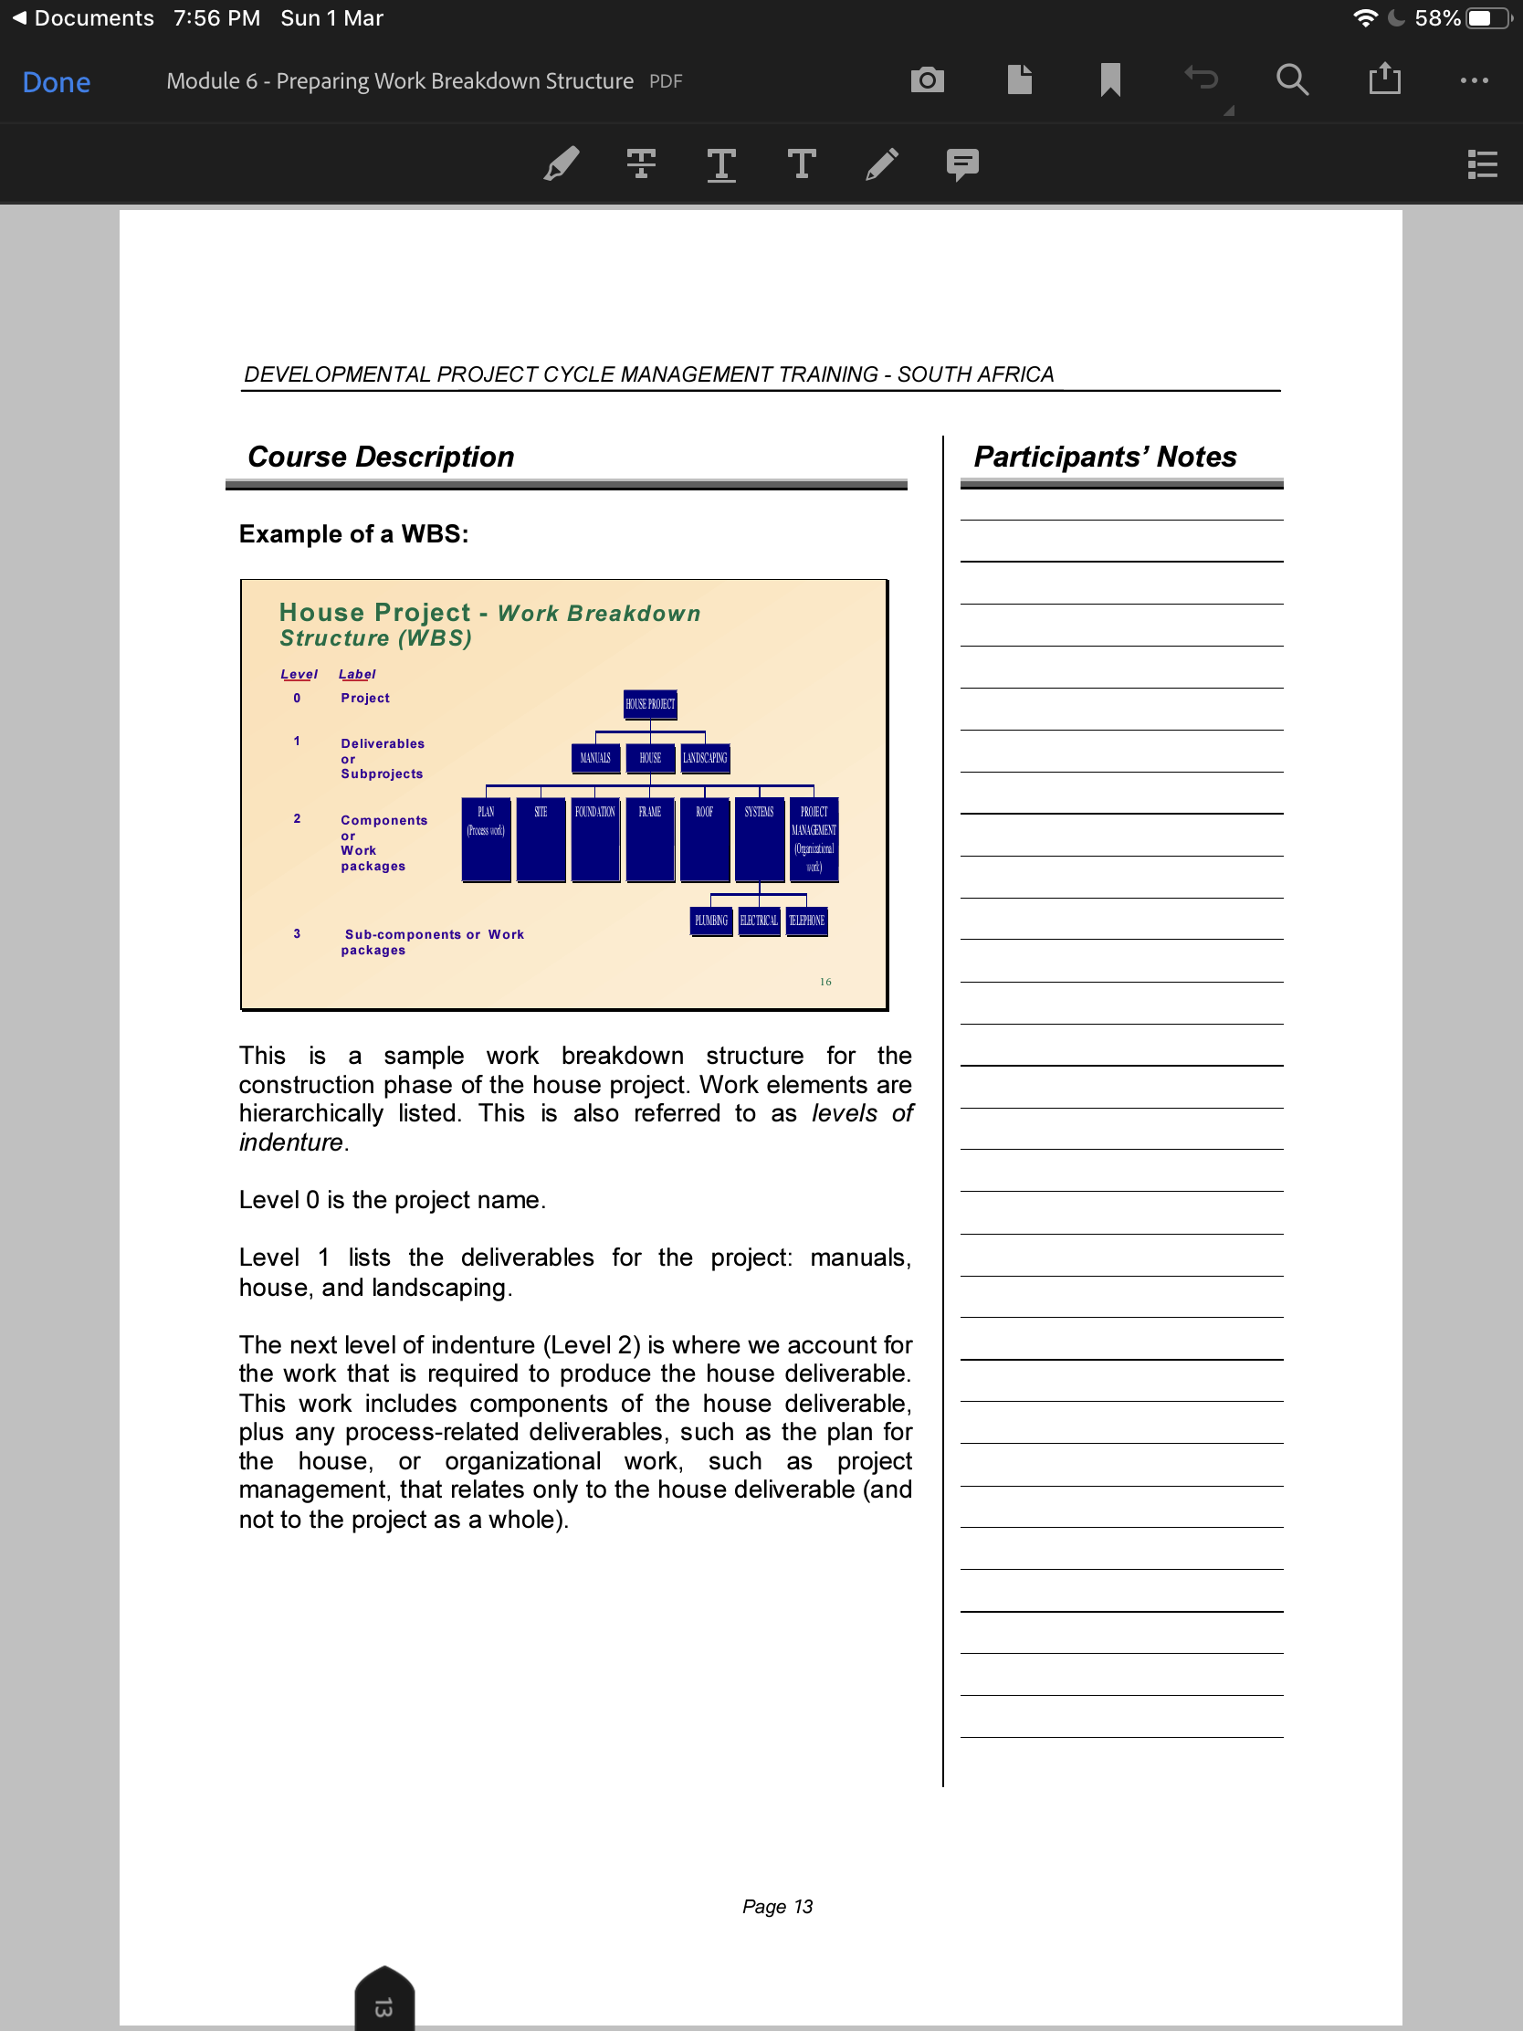

Slide 28
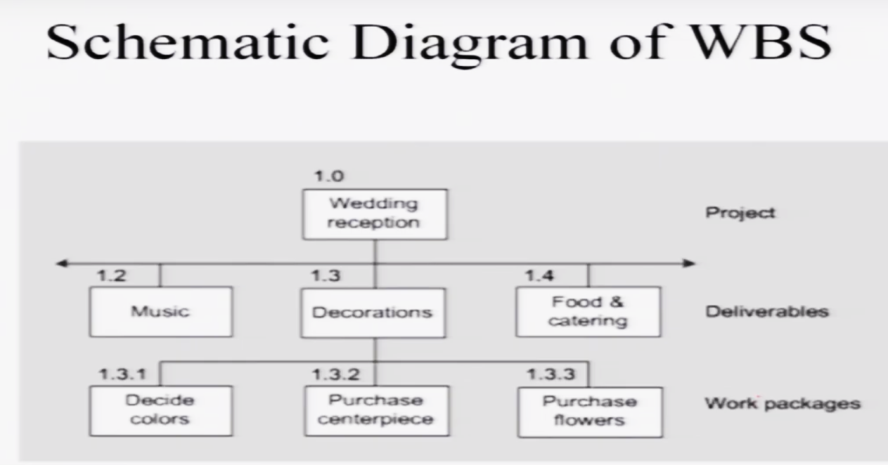

Slide 29
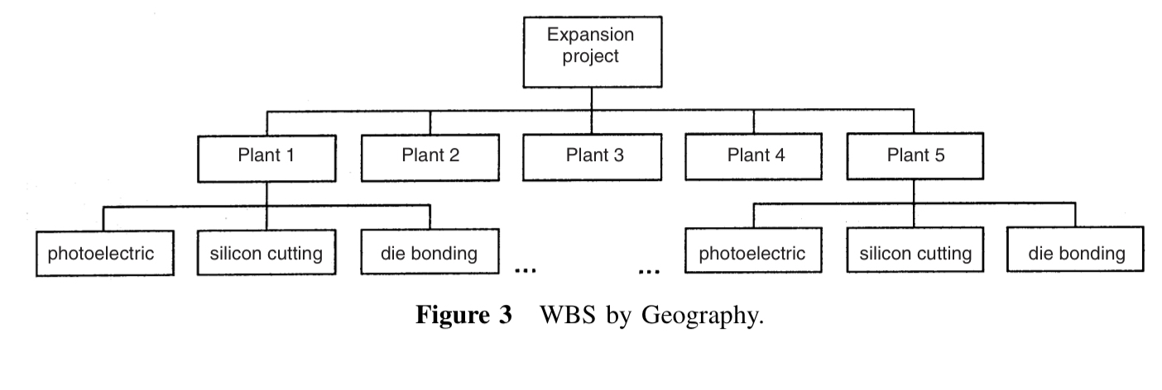

Slide 30
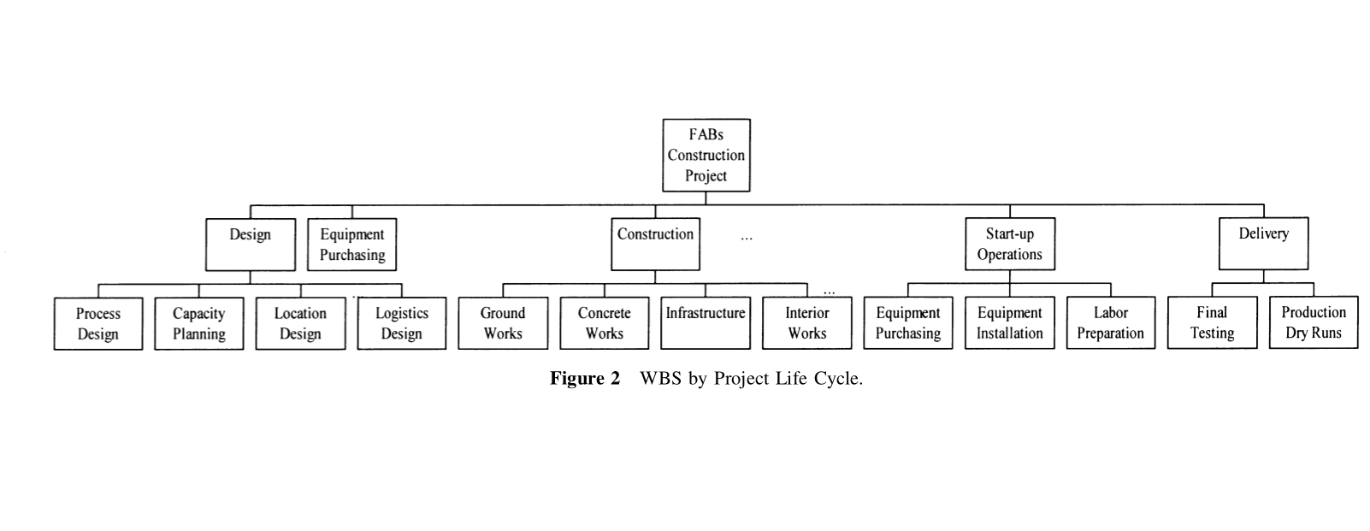

Slide 31
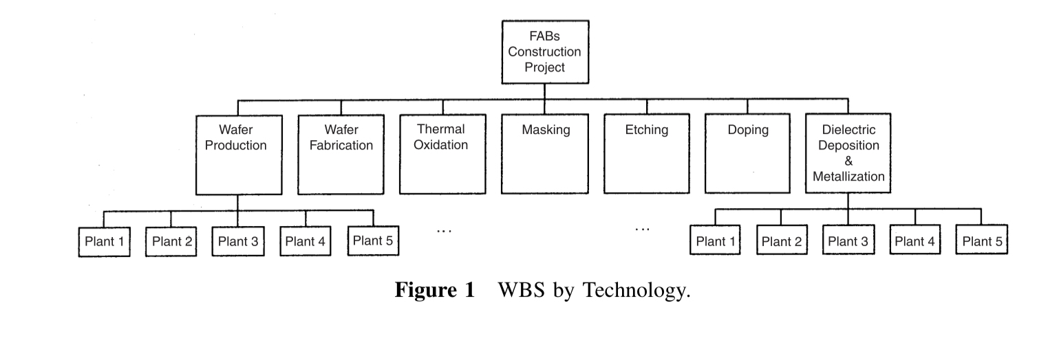

Slide 32
Practice Example
R&D Projects
Managing R&D projects is among the toughest areas in project management. These projects are characterized by a high degree of uncertainty, and consequently a large proportion of them is never completed. The importance of careful planning in this environment cannot be overstated. Create a WBS planned for an R&D project aimed at developing a new product. The second level of this WBS is organized to be made by the project life cycle, and the third level corresponds to functional departments that are involved in the project.

Slide 34
Linear Responsibility Chart

Slide 35
Linear Responsibility Chart

